Slide 1
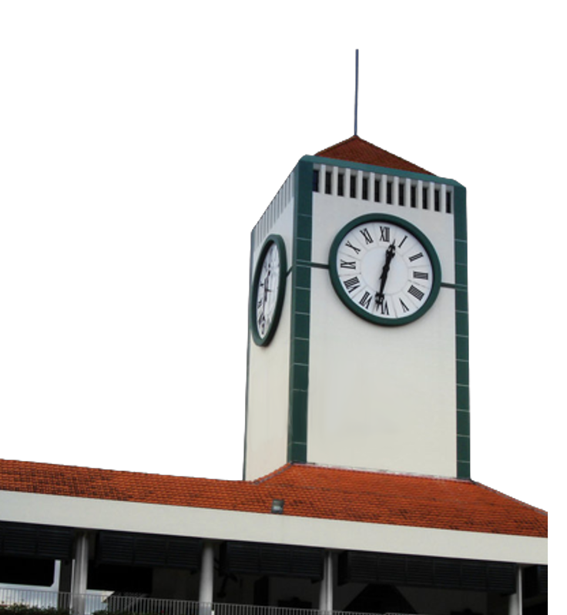
Visit to Raffles Institution
Yang Iiyu U2222686A

Slide 2

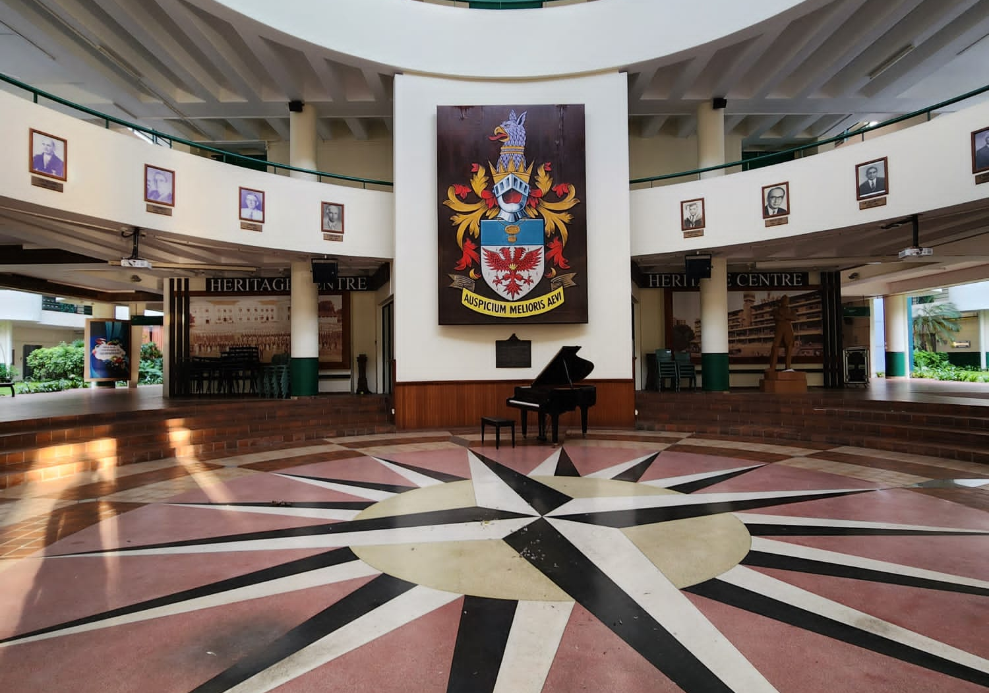
About Me
Raffles Institution Batch of ‘19
Studied in Raffles Institution for 6 Years
Member of Raffles Tennis

Slide 3
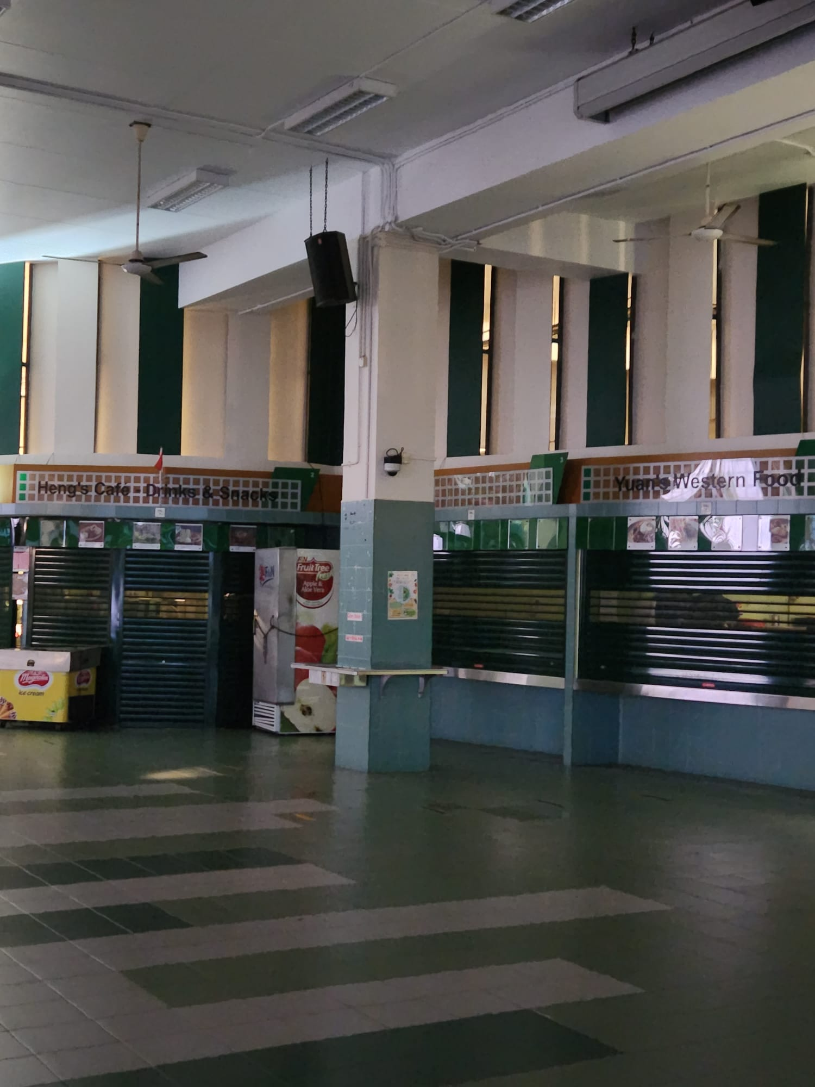
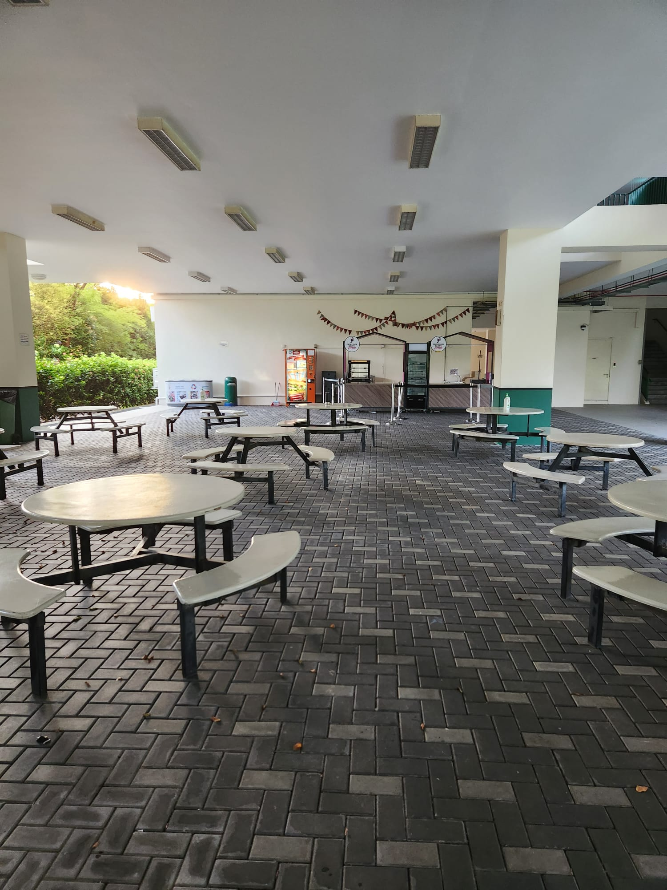
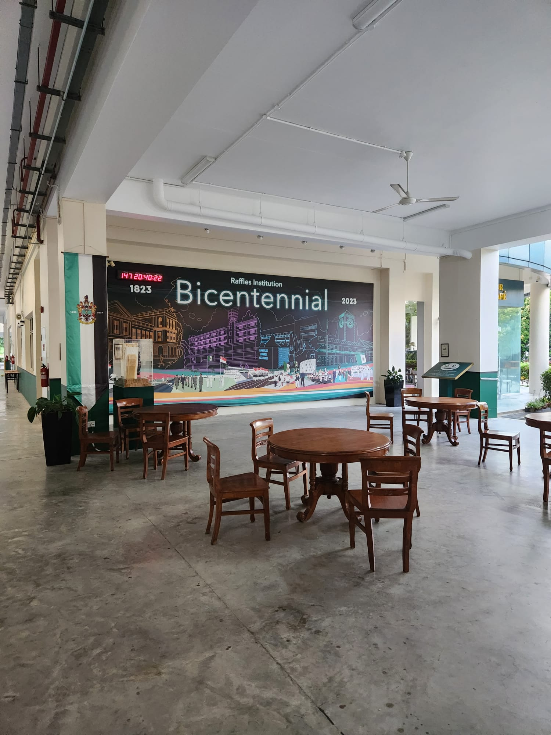
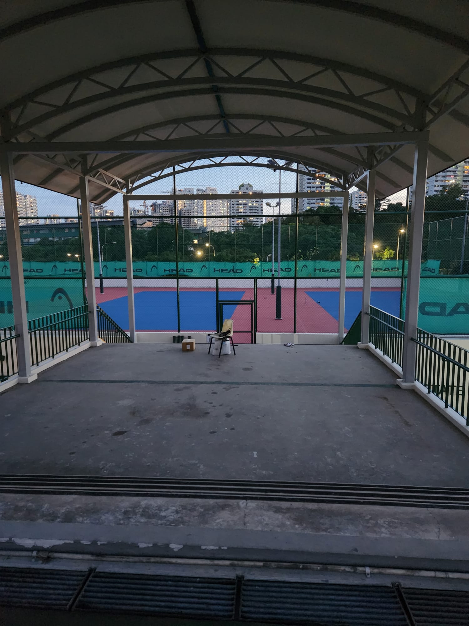
The School

Slide 4
Why is it important for a community to preserve its cultural identity?

Slide 5

Source 1
Can’t Shape the Future if You are Stuck in the Past
Dr. Annie Lockhart-Gilroy
Dr Gilroy recounts her experience working with the locals of a formerly prosperous town
Locals are stuck in a loop of “crippling nostalgia”
Cultural Identity is far too inaccurately passed on to be a useful tool in making progress

Slide 6

Source 2
How can we create a culture of excellence in schools?
Mark Enser
Mark Enser talks about the importance of building a “culture of excellence” in schools, and recommends that schools:
Live demonstration of thought processes
Promote exploration beyond the classroom

Slide 7


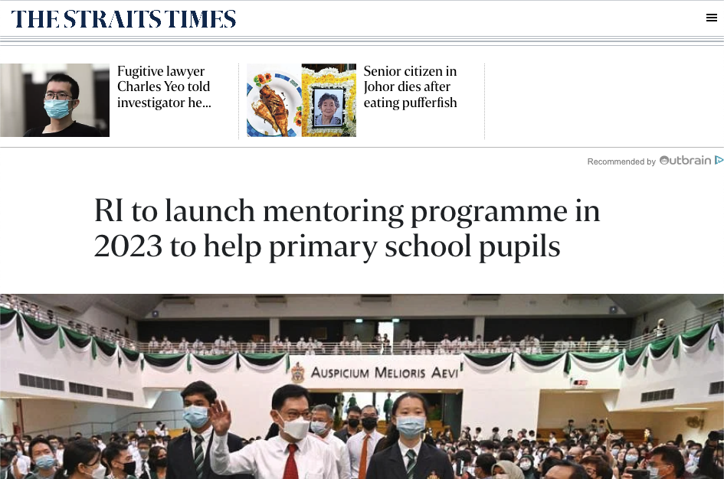
Source 1
Source 2
IF
VS
WHEN
Preserving cultural identity is wasted effort
Building a strong school culture is useful
It builds unrealistic expectations for the future
It sets standards and builds good habits in students

Slide 8
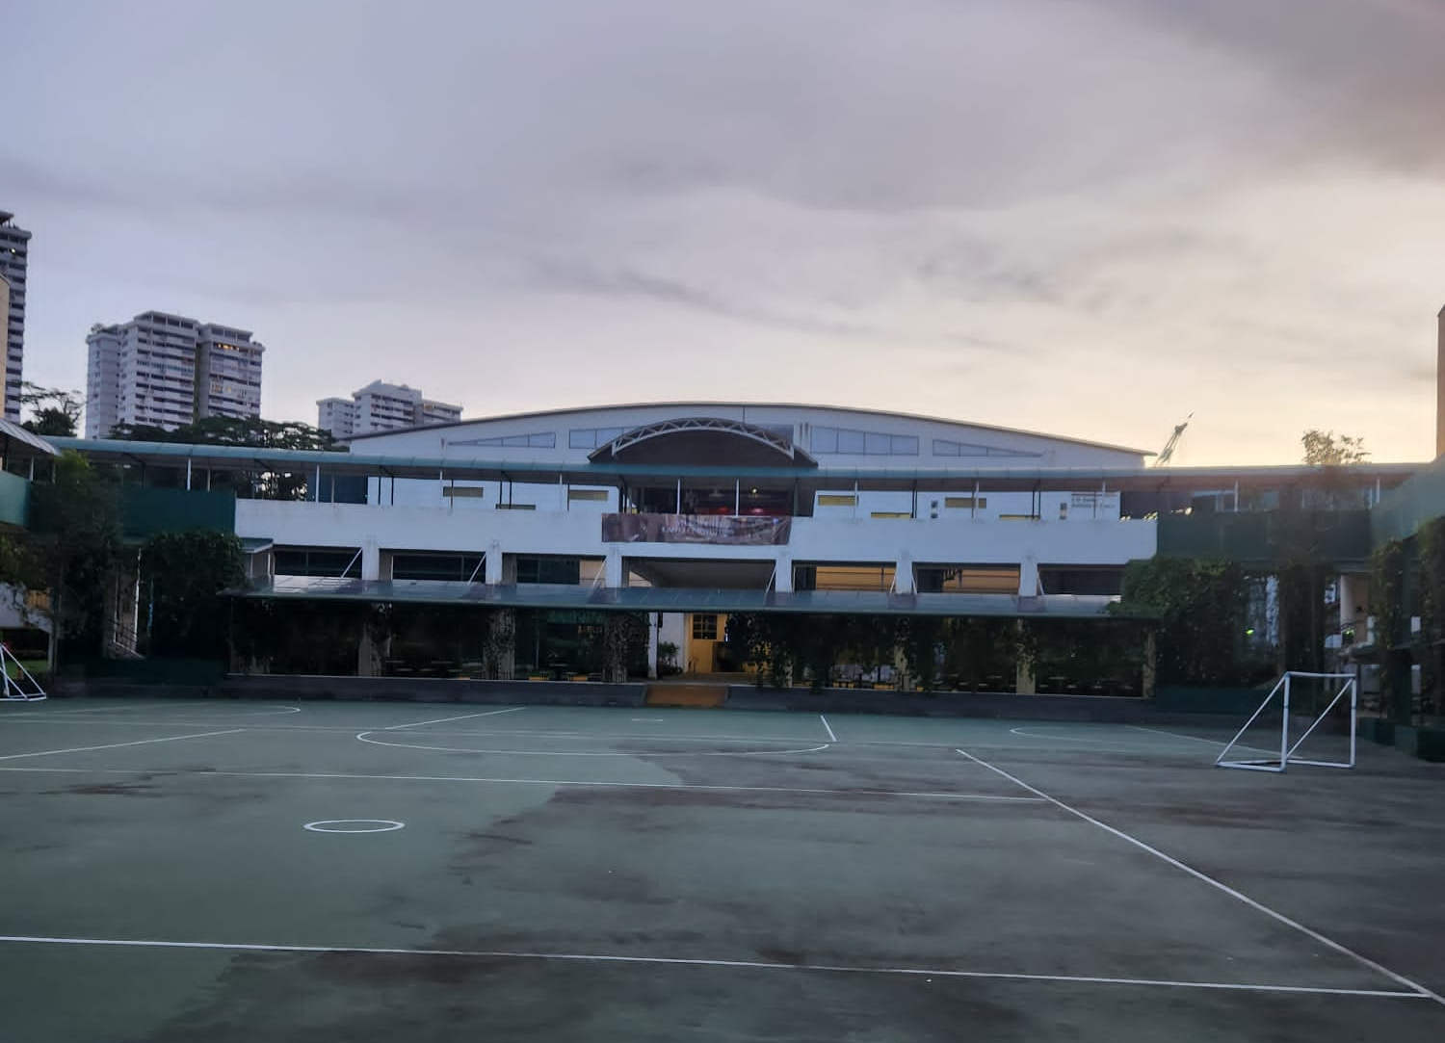
Auspicium Melioris Aevi (Hope of A Better Age)

Slide 9
Thanks
Do you have any questions?
youremail@freepik.com
+91 620 421 838
yourcompany.com
Please keep this slide for attribution

Slide 10
References
https://drew.edu/theological-school/2019/01/11/cant-shape-the-future-if-you-are-stuck-in-the-past/
https://www.theguardian.com/teacher-network/teacher-blog/2017/aug/02/create-culture-excellence-schools-students-teachers
https://d3uwoey2rd901c.cloudfront.net/wp-content/uploads/2018/06/rice-media-meritocracy-is-elitism-2-1024x768.jpg

